Slide 1
Analysing the Characteristics of Neural Networks for the Recognition of Sugar Beets
Luca Brodo – Winter Semester 2021

Slide 2
Why are we here?
We want to find correlations between the characteristics of Neural Networks.
In the settings of sugar beet production
Why sugar beets?

Slide 3
How are we going to do that?
Discover the characteristics we are interested in
Develop a toolbox
Analyse the networks

Slide 4
The characteristics:
Training time
Inference time
Accuracy
Loss

Slide 5
Our Tool:
Relevant
Reproducible
Fair
Verifiable

Slide 6
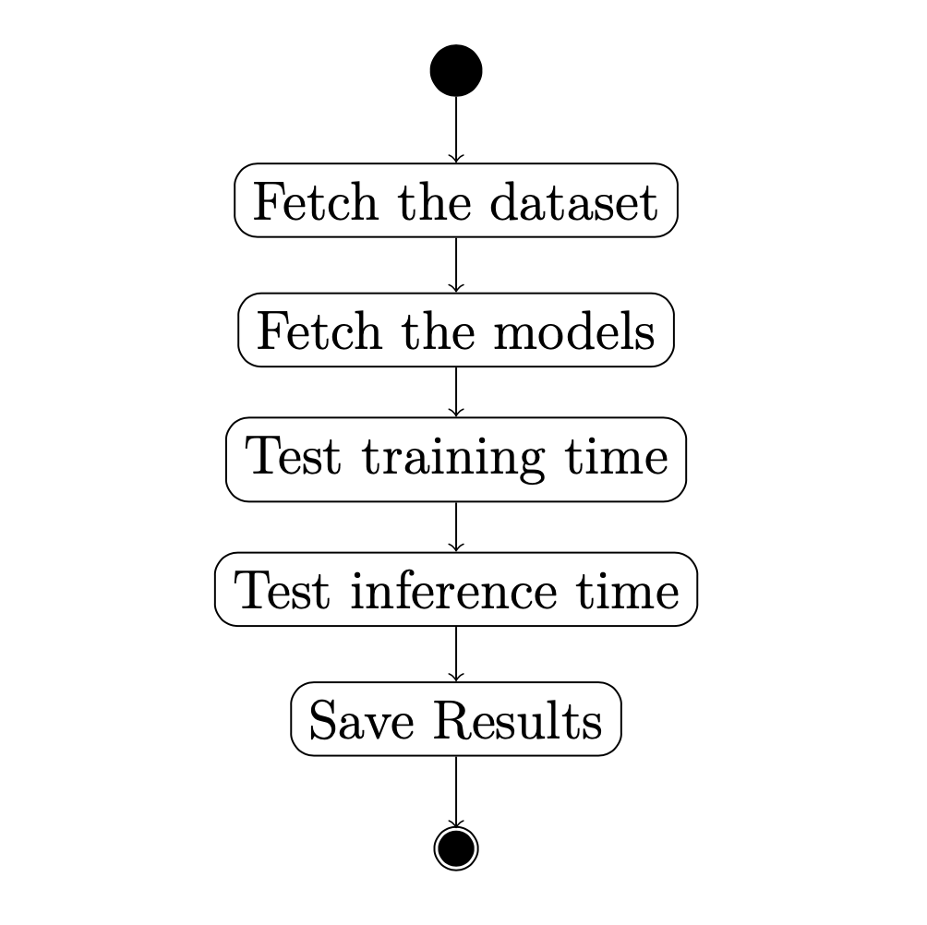

Slide 7
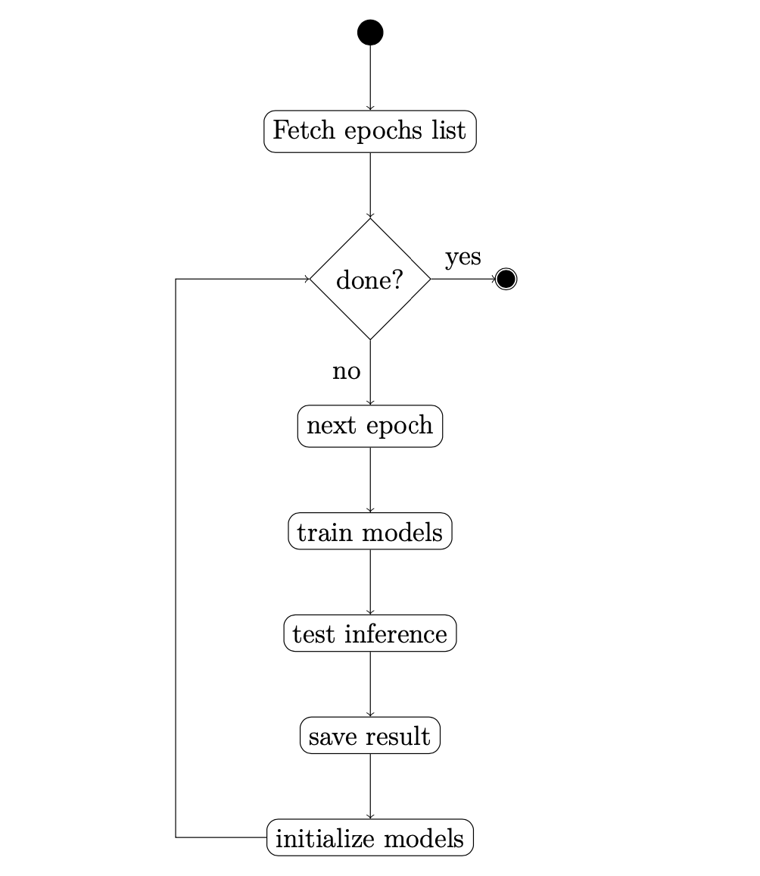

Slide 8
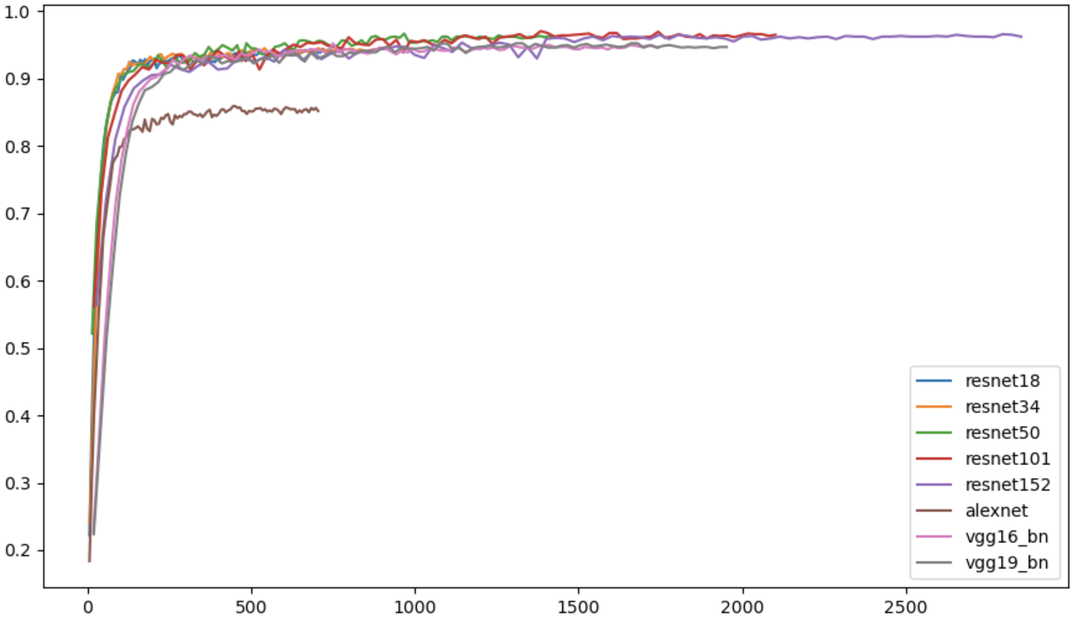
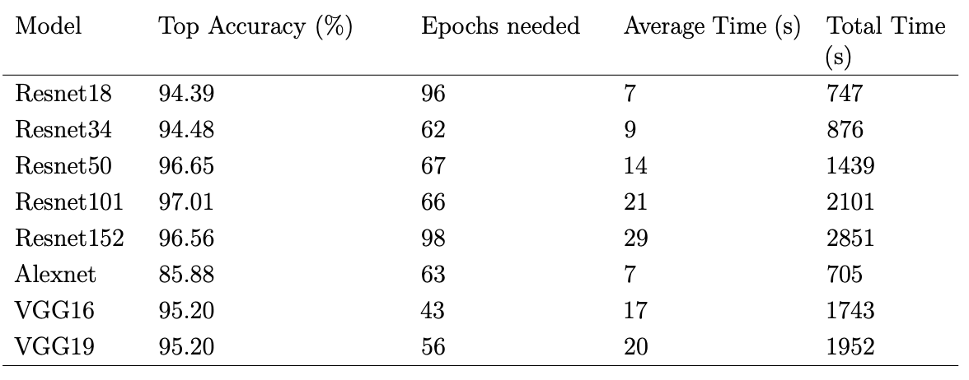
Training time

Slide 9
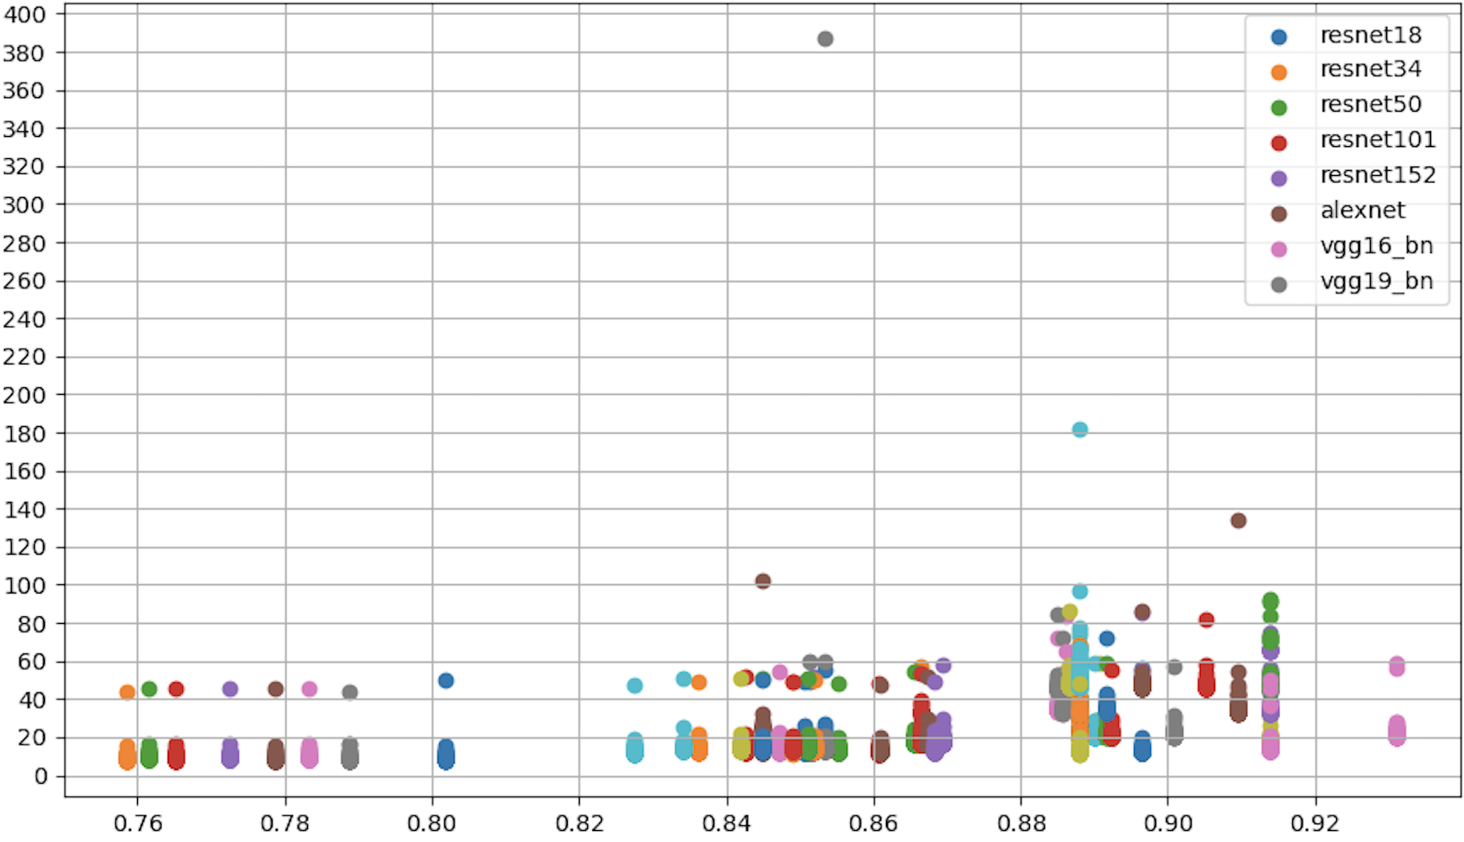
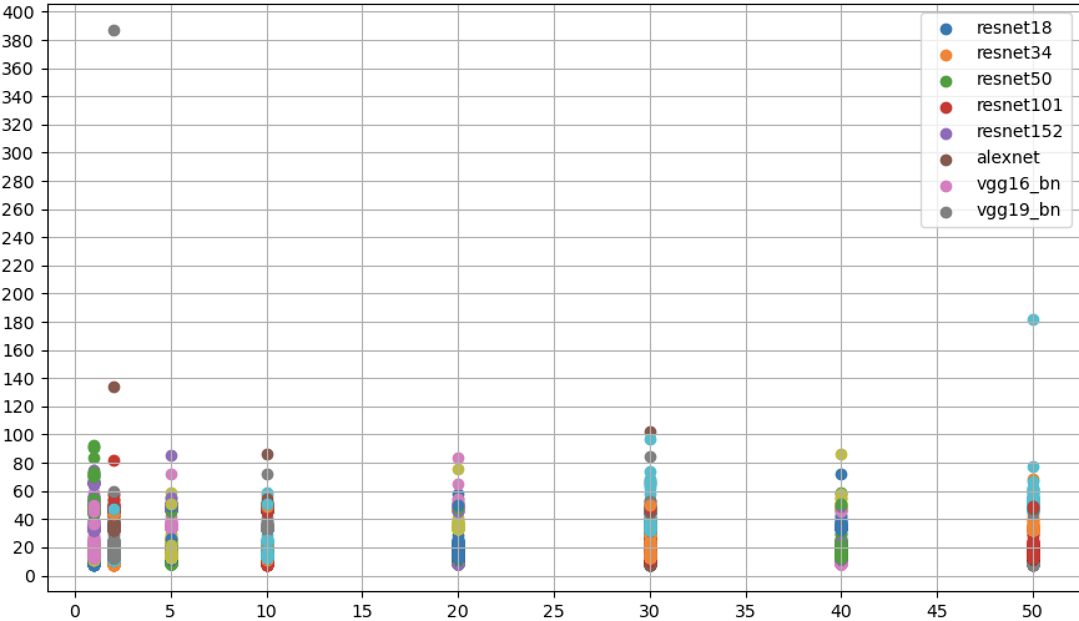
Inference time
Inference time (s)
Accuracy
Epoch

Slide 10
The inference time is related to the amount of the NN layers
Inference time is related to training time
We can relate accuracy to inference time

Slide 11
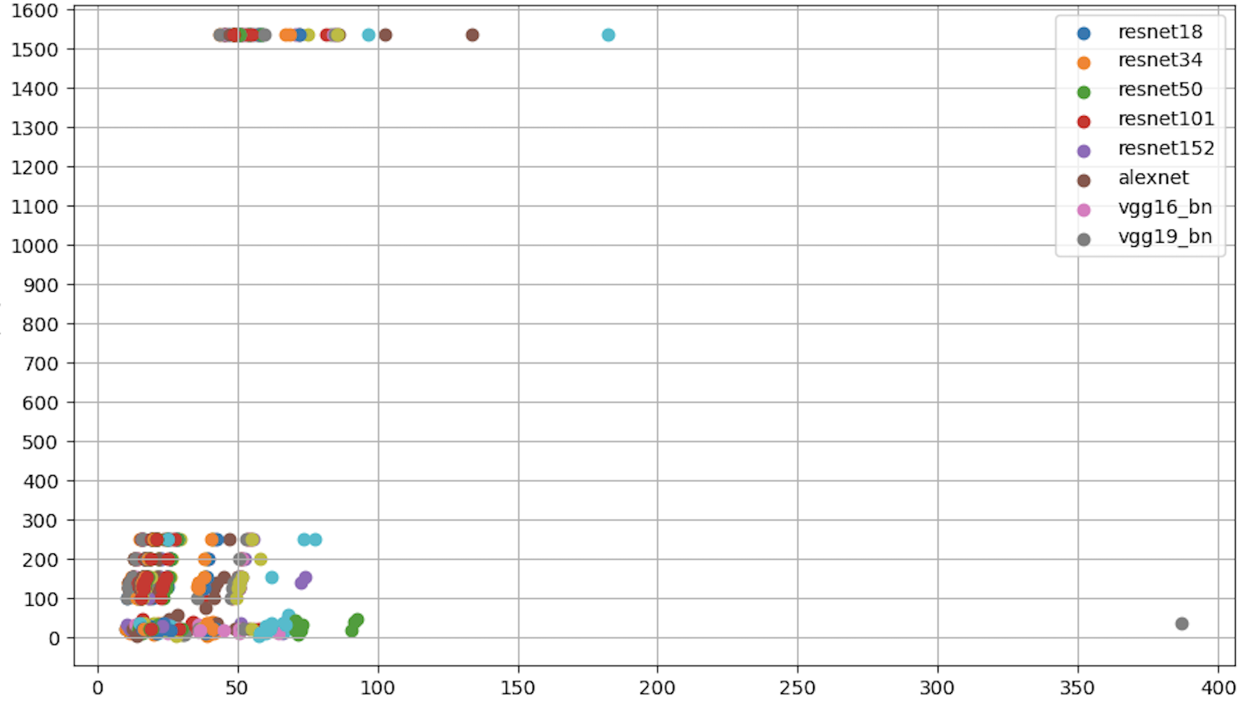
Size (kb)
Inference time

Slide 12
The attributes of the pictures influence inference time
Resolution
Dimensions
If so, we expect bigger pictures to take more time

Slide 13
What else can we do?
Analyse both training and inference time with grey-scale version
Further analysis on the slowest images
Analysis of the training and validation loss

Slide 14
References

